Slide 1

ASSIGNMENT
Title: Lab Assignment 3
Course Code: SP
Submitted To:
AL AKRAM CHOWDHURY
LECTURER
Dept. of Computer Science & Engineering, MU
Submitted By:
ABDULLAH AL MAMUN
ID No : 221-115-109
Batch : 56th
Section : C
Dept. of Computer Science & Engineering, MU
Date of Submission: June 08, 2022

Slide 2
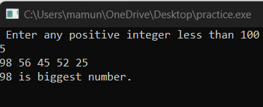
ARRAY
WAP that will take n (n = any positive integer less than 100) from the user and find the biggest number among them.
#include<stdio.h>
int main()
{
int a,i,f;
printf(" Enter any positive integer less than 100\n");
scanf("%d", &a);
int n[a];
for (i=0; i<a; i++)
{
scanf("%d", &n[i]);
}
f=n[0];
for (i=1; i<a; i++)
{
if ( f<n[i])
{
f=n[i];
}
}
printf("%d is biggest number.", f);
getch();
return 0;
}

Slide 3
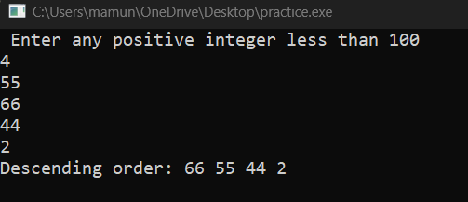
WAP that will take n (n = any positive integer less than 100) from the user and print them in descending order.
#include<stdio.h>
int main()
{
int a,i,j,f=0;
printf(" Enter any positive integer less than 100\n");
scanf("%d", &a);
int n[a];
for (i=0; i<a; i++)
{
scanf("%d", &n[i]);
}
for (i=0; i<a; i++)
{
for (j=i+1; j<a; j++)
{
if ( n[i]<n[j])
{
f=n[i];
n[i]=n[j];
n[j]=f;
}
}
}
printf("Descending order: ");
for (i=0; i<a; i++)
{
printf("%d ", n[i]);
}
getch();
return 0;
}

Slide 4
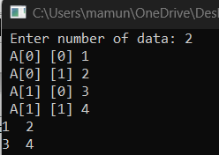
WAP to input the values in a two dimensional array of integers and display the values.
#include<stdio.h>
int main()
{
int a,i,j,f=0;
printf(" Enter number of data: ");
scanf("%d", &a);
int A [a][a];
for (i=0; i<a; i++)
{
for (j=0; j<a; j++)
{
printf(" A[%d] [%d] ",i,j);
scanf("%d", &A[i][j]);
}
}
for (i=0; i<a; i++)
{
for (j=0; j<a; j++)
{
printf("%d ", A[i][j]);
}
printf("\n");
}
return 0;
}

Slide 5
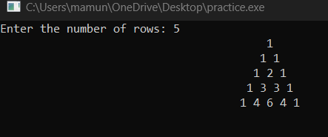
Draw the Pascal’s Triangle using two-dimensional array.
#include<stdio.h>
int main()
{
int n, i, j ;
printf("Enter the number of rows: ");
scanf("%d",&n);
int pascal[n][n];
for(i=0;i<n;++i)
{
for(int s=1; s<=40-i; s++)
printf(" "); //space
for(int j=0;j<=i;++j)
{
if(j==0||j==i) pascal[i][j]=1;
else
pascal[i][j] = pascal[i-1][j-1] + pascal[i-1][j];
printf("%d ",pascal[i][j]);
}
printf("\n");
}
getch();
return 0 ;
}

Slide 6
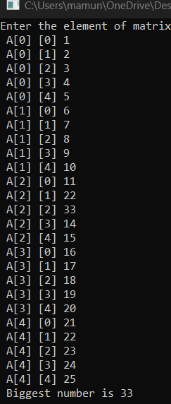
WAP that takes a 5x5 matrix of integer values as input and then find out the biggest number from upper-left to lower bottom diagonal elements of that matrix.
#include<stdio.h>
int main()
{
int i,j,max,A[5][5];
printf("Enter the element of matrix:\n");
for(i=0; i<5; i++)
{
for (j=0; j<5; j++)
{
printf(" A[%d] [%d] ",i,j);
scanf("%d", &A[i][j]);
}
}
max=A[0][0];
for(i=0; i<5; i++)
{
for (j=0; j<5; j++)
{
if(i==j)
{
if (max<A[i][j])
{
max=A[i][j];
}
}
}
}
printf(" Biggest number is %d", max);
getch();
return 0;
}

Slide 7
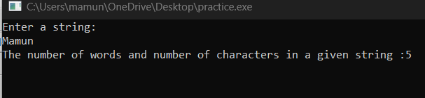
STRING
WAP to count the number of words and number of characters in a given line of text except the spaces.
#include<stdio.h>
#include<string.h>
int main()
{
int n;
char str[100];
printf("Enter a string:\n");
gets(str);
n=strlen(str);
printf("The number of words and number of characters in a given string :%d ", n);
return 0;
}

Slide 8
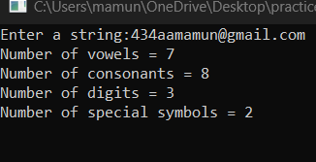
WAP to count the numbers of vowels, consonants, digits and special symbols in a given string.
#include<stdio.h>
int main()
{
char str[100], ch;
int i,vowel,consonant,digit,specialsymbols;
printf("Enter a string:");
gets(str);
i=vowel=consonant=digit=specialsymbols=0;
while((ch=str[i])!= '\0')
{
if (ch=='a'|| ch=='e'|| ch=='i'|| ch=='o'|| ch=='u'|| ch=='A'|| ch=='E'|| ch=='I'|| ch=='O'|| ch=='U')
vowel++;
else if ((ch>='a' && ch<='z')|| (ch>='A' && ch<='Z'))
consonant++;
else if (ch>='0' && ch<='9')
digit++;
else
specialsymbols++;
i++;
}
printf("Number of vowels = %d\n",vowel);
printf("Number of consonants = %d\n",consonant);
printf("Number of digits = %d\n",digit);
printf("Number of special symbols = %d\n",specialsymbols);
getch();
}

Slide 9
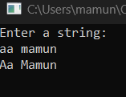
WAP to input a multi word string and produce a string in which first letter of each word is capitalized.
#include<stdio.h>
#include<string.h>
int main()
{
int i,n;
char str[100],f;
printf("Enter a string:\n");
gets(str);
n=strlen(str);
str[0]=toupper(str[0]);
for (i=0; i<n; i++)
{
if ( str[i]==' ')
{
str[i+1]=toupper(str[i+1]);
}
}
for (i=0; i<n; i++)
{
printf("%c", str[i]);
}
getch();
return 0;
}

Slide 10

WAP to reverse a string.
#include<stdio.h>
int main ()
{
char str1[]="MAMUN";
strrev(str1);
printf("str1 = %s\n", str1);
getch();
}

Slide 11
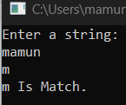

WAP to search a character in a given string.
#include<stdio.h>
#include<conio.h>
#include<string.h>
int main()
{
int i,n;
char string[100],f;
printf("Enter a string:\n");
gets(string);
n=strlen(string);
scanf("%c", &f);
for (i=0; i<n; i++)
{
if (string[i]==f)
{
n=1;
break;
}
else
{
n=0;
}
}
if (n==1)
{
printf("%c Is Match.\n", f);
}
else
{
printf("%c Is Not Match.\n", f);
}
return 0;
}

Slide 12

WAP to input a string and replace every lower case letter with upper case letter, upper case letter with a lower case letter, digit with a ‘#’ and a special symbol with a ‘%’. Display the new string.
#include<stdio.h>
#include<string.h>
int main()
{
int i,n,v=0,c=0,d=0,s=0;
char string[100],f;
printf("Enter a string:\n");
gets(string);
n=strlen(string);
for (i=0; i<n; i++)
{ f=string[i];
if (f>= 'A' && f<='Z')
{
string[i]=tolower(f);
}
else if (f>= 'a' && f<='z')
{
string[i]=toupper(f);
}
else if (f>= '0' && f<='9')
{ string[i]='#';
}
else
{ string[i]='%';
}
}
for (i=0; i<n; i++)
{
printf("%c", string[i]);
}
return 0;
}

Slide 13
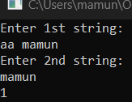
pointer
Write a function to compare two strings using pointers. Function has two string arguments and returns 0 if strings are equal else returns 1.
#include<stdio.h>
#include<string.h>
#define max 100
int main()
{
char a[max],a1[max], *b, *b1;
int flag=0;
printf("Enter 1st string: \n");
gets(a);
printf("Enter 2nd string: \n");
gets(a1);
b = &a;
b1 = &a1;
while(*b!='\0' || *b1!='\0')
{
if(*b != *b1)
{
flag = 1;
break;
}
*b++;
*b1++;
}
if(flag == 0)
printf("0");
else
printf("1");
getch();
return 0;
}

Slide 14
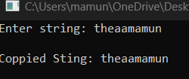
Write a program that will copy one string to another. You can’t use strcpy() function.
#include<stdio.h>
#include<string.h>
#define max 100
int main()
{
char a[max],a1[max], *b, *b1;
printf("Enter string: ");
gets(a);
b = &a;
b1 = &a1;
while(*b!='\0')
{
*b1 = *b;
*b++;
*b1++;
}
*b1='\0';
printf("\nCoppied Sting: %s",a1);
getch();
return 0;
}

Slide 15
Write a function having one argument of string type and print the string in the following pattern using pointers.
R RAJAT
RA RAJA
RAJ RAJ
RAJA RA
RAJAT R
#include<stdio.h> #include<string.h> int main() { char s[ ]="RAJAT"; int i,j,len; len= strlen(s); for(i=0; i<len; i++) { for(j=0; j<=i; j++) { printf("%c",s[j]); } printf("\n"); } return 0; } | #include<stdio.h> #include<string.h> int main() { char s[ ]="RAJAT"; int i,j,len; len= strlen(s); for(i=len-1; i>=0; i--) { for(j=0; j<=i; j++) { printf("%c",s[j]); } printf("\n"); } return 0;

Slide 16

Function
Write a function that takes one integer argument and returns its square.
#include<stdio.h>
int sqr(int n)
{
return n*n;
}
int main()
{
int x;
printf("enter a number: ");
scanf("%d",&x);
int sqrt = sqr(x);
printf("square of %d = %d",x,sqrt);
return 0;
}

Slide 17
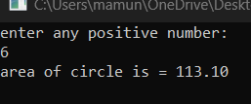
Write a function to calculate the area of a circle where radius is passed to the function as
argument.
#include<stdio.h>
#define pi 3.1416
double area(double radius)
{
return pi*radius*radius;
}
int main()
{
double x;
printf("enter any positive number: \n");
scanf("%lf",&x);
double rad = area(x);
printf("area of circle is = %.2lf\n",rad);
return 0;
}

Slide 18



Write a function that has one character argument and displays that it’s a small letter, capital
letter, a digit or a special symbol.
#include<stdio.h>
void charec(char si)
{
if(si>=65 && si<=90)
printf("CAPITAL LETTER\n");
else if(si>=97 && si<=122)
printf("SMALL LETTER\n");
else if(si>=48 && si<=57)
printf("DIGIT\n");
else
printf("SPECIAL SYMBOL\n");
}
int main()
{
char s;
scanf("%c",&s);
charec(s);
return 0;
}

Slide 19

Write a function to print the sum and average of first n odd numbers where n is passed to the function as argument.
#include<stdio.h>
void sum(int num)
{
int i,s=0,c=0;
for(i=1; i<=num; i++)
{
if(i%2!=0)
{
s+=i;
c++;
}
}
printf("Sum is: %d\n",s);
printf("Avg is: %.2lf\n",(double)s/c);
}
int main()
{
int n;
printf("enter number: ");
scanf("%d",&n);
sum(n);
return 0;
}

Slide 20


Write a function that returns 1 if the number is prime and 0 if not prime. Number is passed to
the function as argument
#include<stdio.h>
void prime(int num)
{
int i,c=0;
for(i=2; i<num; i++)
{
if(num%i==0)
{
c++;
}
}
if(c==0)
printf("1\n");
else
printf("0\n");
}
int main()
{
int n;
printf("enter number: ");
scanf("%d",&n);
prime(n);
return 0;
}

Slide 21
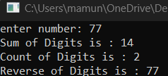
Write a function that prints the sum of the digits, count of the digits and reverse of a number. Number is passed to the function as argument.
#include<stdio.h>
void scr(int num)
{
int i,c=0,rem,sum=0,sum1=0;
while(num!=0)
{
rem = num%10;
sum = sum + rem;
sum1 = sum1*10 + rem;
num = num/10;
c++;
}
printf("Sum of Digits is : %d\n",sum);
printf("Count of Digits is : %d\n",c);
printf("Reverse of Digits is : %d\n",sum1);
}
int main()
{
int n;
printf("enter number: ");
scanf("%d",&n);
scr(n);
return 0;
}

Slide 22
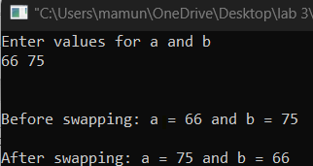
Write a program to take two numbers as input and function to swap them by passing
parameters as values and also as addresses.
#include<stdio.h>
void swap(int, int);
int main()
{
int a, b;
printf("Enter values for a and b\n");
scanf("%d%d", &a, &b);
printf("\n\nBefore swapping: a = %d and b = %d\n", a, b);
swap(a, b);
return 0;
}
void swap(int x, int y)
{
int temp;
temp = x;
x = y;
y = temp;
printf("\nAfter swapping: a = %d and b = %d\n", x, y);
}

Slide 23

Write a recursive function that will find the average of an integer.
#include<stdio.h>
float avg(float a)
{
if(a!=0)
{
return a/2;
}
else
{
return a;
}
}
int main()
{
float m,result;
printf("Enter number: ");
scanf("%f", &m);
result=avg(m);
printf("%.2f ",result);
getch();
return 0;
}

Slide 24

Write a recursive function that will find the GCD of two numbers.
#include <stdio.h>
int A(int n1, int n2);
int main() {
int n1, n2;
printf("Enter two positive integers: ");
scanf("%d %d", &n1, &n2);
printf("G.C.D of %d and %d is %d.\n", n1, n2, A(n1, n2));
return 0;
}
int A(int n1, int n2) {
if (n2 != 0)
return A(n2, n1 % n2);
else
return n1;
}

Slide 25

Write a function that receives a string (character array) as argument and produce a string in which first letter of each word is capitalized.
#include<stdio.h>
void transfer(char a[])
{
int i,n;
n=strlen(a);
a[0]=toupper(a[0]);
for (i=0; i<n; i++)
{
if ( a[i]==' ')
{
a[i+1]=toupper(a[i+1]);
}
}
for (i=0; i<n; i++)
{
printf("%c", a[i]);
}
}
int main()
{
int string[100];
printf("Enter a line:");
gets(string);
transfer(string);
getch();
return 0;
}

Slide 26
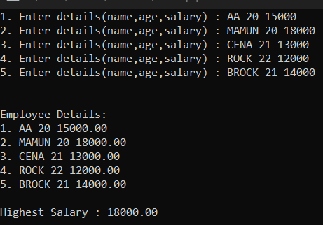
Structure
WAP that takes name, age and salary of 5 employees as input and stores it in structure employee and displays all the
employee details through emp_disp function and displays employee details of employee who gets highest salary
using emp_sal function.
#include<stdio.h>
#define p 5
void emp_disp();
void emp_sal();
struct details
{
char name[100];
int age;
float salary;
} emp[100];
int main()
{
int i;
for (i=0; i<p; i++)
{
printf("%d. Enter details(name,age,salary) : ", i+1);
scanf("%s %d %f", &emp[i].name,&emp[i].age,&emp[i].salary);
}
emp_disp();
emp_sal();
getch();
return 0;
}
void emp_disp()
{
int i;
printf("\n\nEmployee Details:\n");
for (i=0; i<p; i++)
{
printf("%d. %s %d %.2f\n", i+1,emp[i].name,emp[i].age,emp[i].salary);
}
}
void emp_sal()
{
int i;
float max;
max=emp[0].salary;
for (i=0; i<p; i++)
{
if(max<emp[i].salary)
{
max=emp[i].salary;
}
}
printf("\nHighest Salary : %.2f", max);
}

